Slide 1
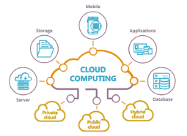


Slide 2
Load Balancing
❐ Improves the distribution of workloads across multiple computing resources
■
Some resources will be busy while others are idle
❐
Aims to
Optimize resource use
Maximize throughput
Minimize response time
Avoid overload of any single resource
■   

Slide 3
Load Balancing
❐
Counter by distributing load equally
■
When cost of problem is well understood (e.g., matrix multiplication, known tree walk) this is possible
❐
Some other problems are not that simple
- Hard to predict how workload will be distributed
- dynamic load balancing used
- But require communication between tasks
❐
2 methods for dynamic load balancing
Task queues vs. work stealing
■

Slide 4
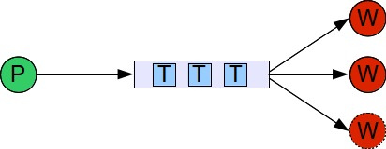
Task Queues
Multiple instance of task queues (producer
consumer)
Threads comes to the task queue after finishing a
task & grab next task
Typically run with a pool of workers
Source: http://blog.zenika.com

Slide 5
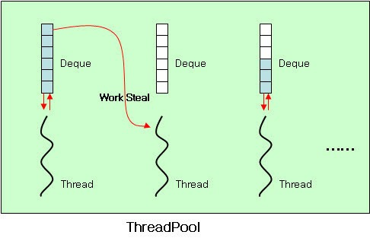
Work Stealing
❐ 
Every worker has a task queue
When 1 worker runs out of work, it goes to other
worker’s queue & “steal” the work
Source: http://karlsenchoi.blogspot.com

Slide 6
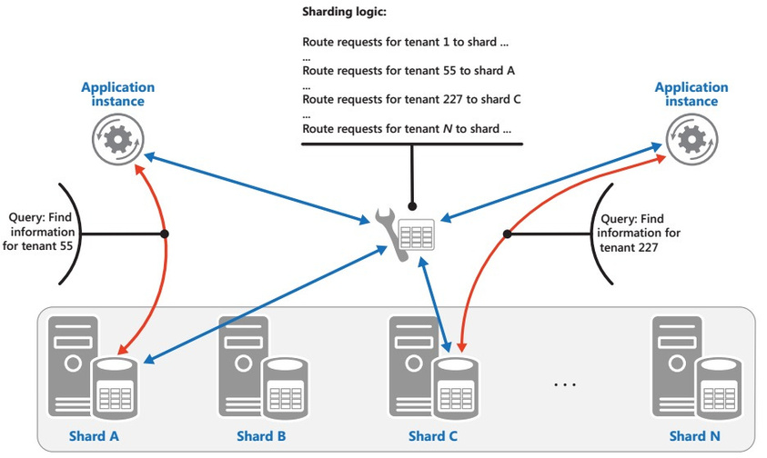
Sharding Pattern
❐
Divide a data store into a set of horizontal partitions or shards to improve scalability

Slide 7
Sharding Pattern (Cont)
❐ When
■   
Limited storage space
Large computation requirement Network bandwidth Geographical constraints
❐
Sharding Strategies
■ 
Lookup Strategy – map request using a shard key
Range Strategy – groups related items together in the same
shard
Hash Strategy – shard decided based on hashing data attributes
■

Slide 8
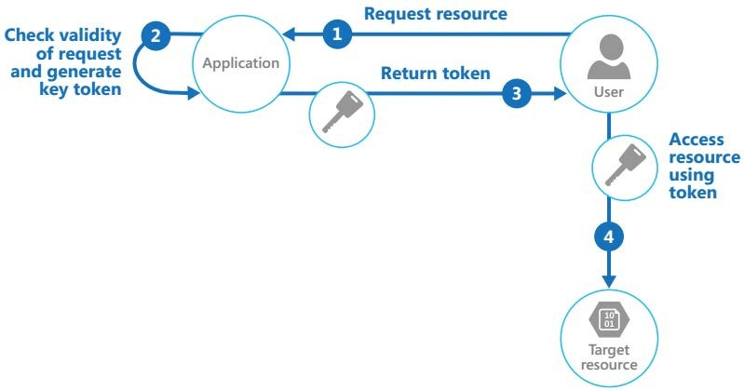
Valet Key Pattern
❐
Use a token or key that provides client with restricted direct access to a specific resource or service

Slide 9
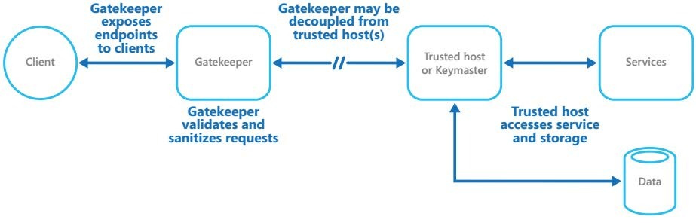
Gatekeeper Pattern
❐
Protect applications & services using a dedicated host instance that acts as a broker
■ 
Validates & sanitizes requests
Passes requests & data between them

Slide 10
Gatekeeper Pattern (Cont.)
❐ 
Only function is to validate & sanitize requests Should use secure communication between
gatekeeper & trusted hosts
❐ Internal end point must connect only to
gatekeeper
Gatekeeper must run in limited privilege mode
May use multiple gatekeepers for availability
❐ 

Slide 11
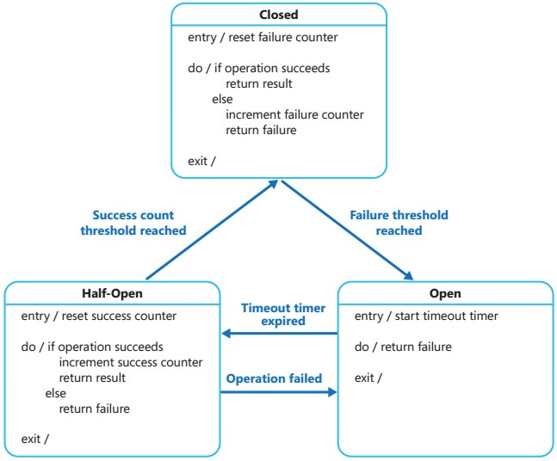
Circuit Breaker Pattern

Slide 12
Circuit Breaker Pattern (Cont.)
When
■
Handle faults that may take a variable amount of time to rectify when connecting to a remote service/resource
When a simple retry will not work
Prevent application from getting tied-up due to retry
■ 
Half-Open State
■
Allow checking whether service is responding by issuing a limited set of requests
Prevent repeated system failures due to rapid
load/volume

Slide 13
Circuit Breaker Pattern (Cont.)
❐
Parameters
■    
Types of exceptions Handling exceptions Logging & replay
Testing failed operations Manual reset

Slide 14
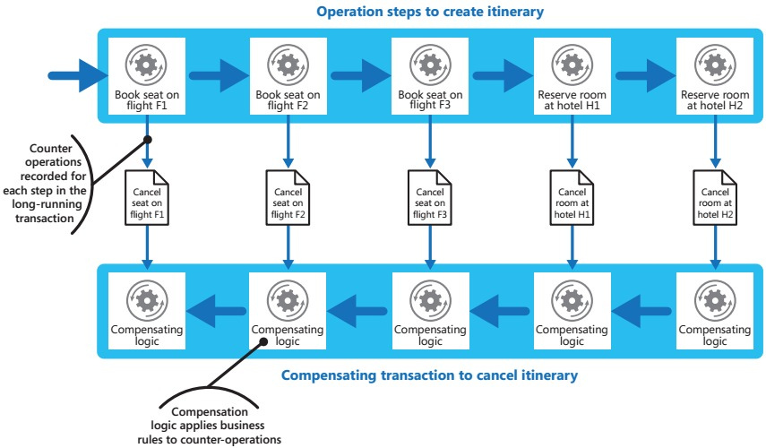
Compensating Transaction Pattern

Slide 15
Compensating Transaction Pattern (Cont.)
❐ Undo work performed by a series of steps, which
together define an eventually consistent operation
❐ Implement a workflow
■
As operation proceeds, system records information about each step & how the work by that step can be undone
If operation fails at any point, workflow rewinds
back through steps it has completed while performing
work that reverses each step

Slide 16
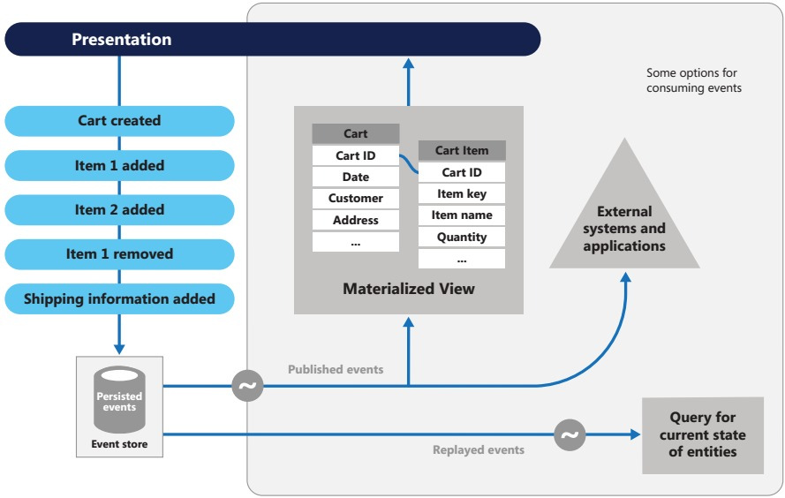
Event Sourcing Pattern

Slide 17
Event Sourcing Pattern (Cont.)
❐ 
Record full series of events than current state Pros
■
Avoid requirement to synchronize data
❐
Traditional Create, Read, Update, & Delete (CRUD) model too slow
Improve performance with eventual consistency
❐
■   
Scalability
Responsiveness
Provide consistency for transactional data Full audit trails
❐
Cons
■
Consistency relaxed

Slide 18
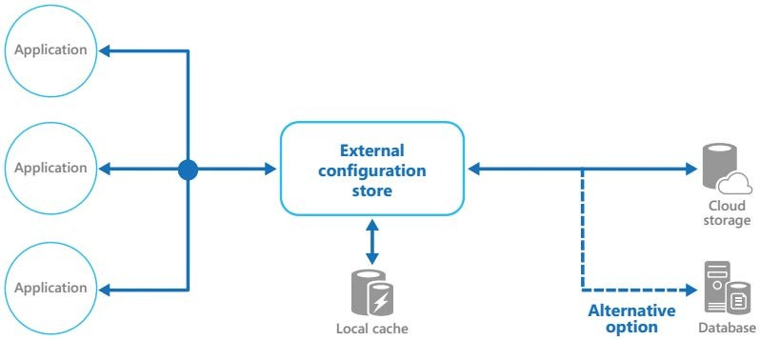
External Configuration Store Pattern
❐
Move configuration information out of application deployment package to a central location

Slide 19
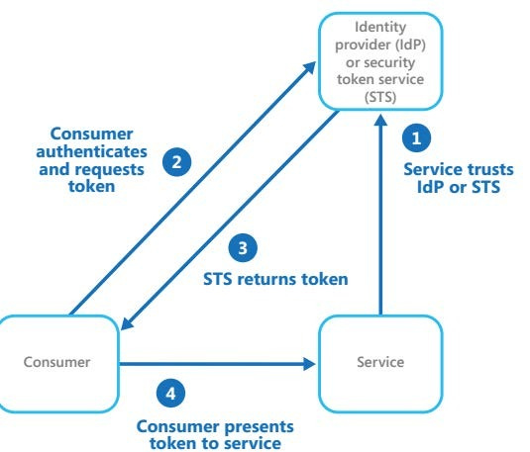
Federated Identity Pattern
❐
Delegate authentication to an external identity provider

Slide 20
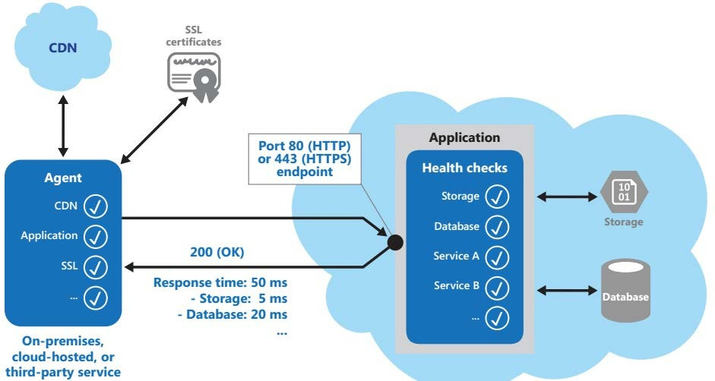
Health Endpoint Monitoring Pattern
❐
Functional checks within an application that external tools can access through exposed endpoints at regular intervals

Slide 21
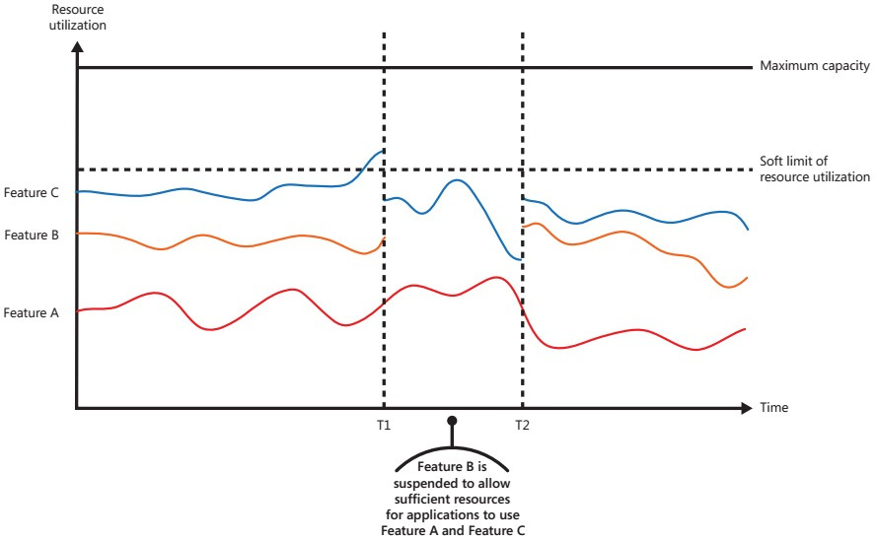
Throttling Pattern
❐ 
Control consumption of resources used by an instance
Allow system to continue to function & meet SLA even
when an increase in demand places an extreme load on resources
21

